Slide 1
OOP PROJECT
Complaint Management
System
CMS
Object Oriented Programming Project - Built Using C++ & File Handling
Group members:
Name: Muhammad Amaan Akbar
Enrollment: 09-131252-043
Name: Muhammad Jazib
Enrollment: 09-131252-049
Role-Based Login
File Persistence
Audit Logging
Complaint Tracking

Slide 2
Table of Contents
01
Project Overview 📘
02
OOP Concepts Used ⚙
Purpose, goals, and system introduction
Classes, inheritance, encapsulation, and more
03
System Architecture 🧩
04
Key Features ✨
Class hierarchy and design structure
User and admin functionality breakdown
05
Data & Persistence 💾
06
System Flow 🔄
File I/O and audit logging
How the system works end-to-end

Slide 3
01 Project Overview
What is the CMS?
2
7
A C++ console-based application that allows users to file, track, and manage complaints digitally through secure role-based dashboards.
User Roles
Complaint Categories
3
3
Project Goals
Priority Levels
Data Files Persisted
🎯 OOP Principles
Classes, inheritance, encapsulation
🔐 Secure Login
Role-based authentication
💾 File Persistence
Data stored using file handling
📋 Complaint Lifecycle
Register, track, manage
Tech Stack
C++ · STL Vectors · File Streams ANSI Colors · Windows API

Slide 4
02 OOP Concepts Used
Classes & Objects
class Dashboard : public Login
Inheritance
Login class manages authentication
CODE:
class Dashboard : public Login
Dashboard class manages system operations
Login
Complaint, User, Auditlog used as data objects
Dashboard inherits all Login functionalities
Reduces code duplication
Dashboard
Improves code reusability
Encapsulation
File I/O & Persistence
Sensitive data stored inside classes
Public interface exposes only menu-driven functions
Data stored permanently using text files
Data accessed only through public functions
ifstream and ofstream used for file operations
save() and load() methods manage records
Abstraction
STL Vectors
Complex operations divided into simple functions:
. Login() . adminDashboard() . registerComplaint() . showStatistics()
vector<Complaint> complaints; vector<AuditLog> auditLogs;
Dynamic storage of complaints and logs
Efficient data management using STL containers

Slide 5
03 System Architecture
Login
Authentication · User Store
addUser · deleteUser · login
extends
Dashboard (inherits Login)
Complaints · AuditLogs · All UI Menus
userDashboard · adminDashboard
Complaint
User
AuditLog
id · trackingNo · status
category · priority · save/load
username · password · role
save · load
timestamp · actor · action
save · load
complaints.txt
users.txt
audit.txt

Slide 6
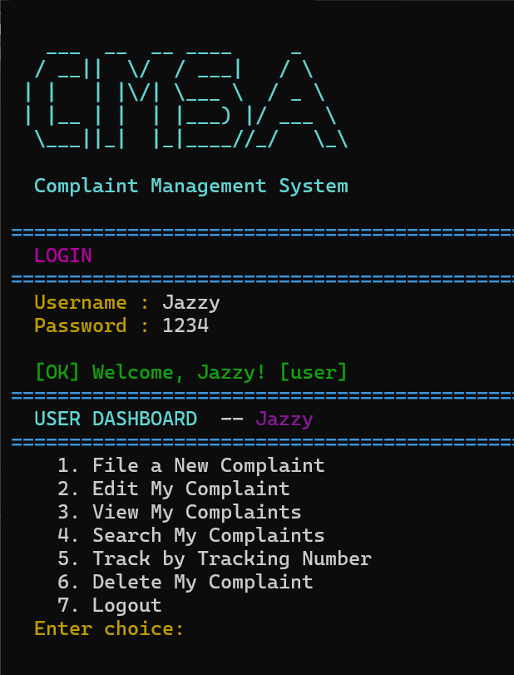
04 User Features
1
📝 File a Complaint
🗑 Delete Complaint
6
Users can register complaints with category, priority, and description.
Users can delete their own pending complaints securely.
2
✏ Edit Complaint
Pending complaints can be updated before admin review.
3
📂 View Complaints
Users can filter complaints by status and view admin notes.
4
🔍 Search Complaints
Keyword-based search for quick complaint lookup.
5
🎫 Track Complaint
Track complaint status using unique CMS tracking number.

Slide 7
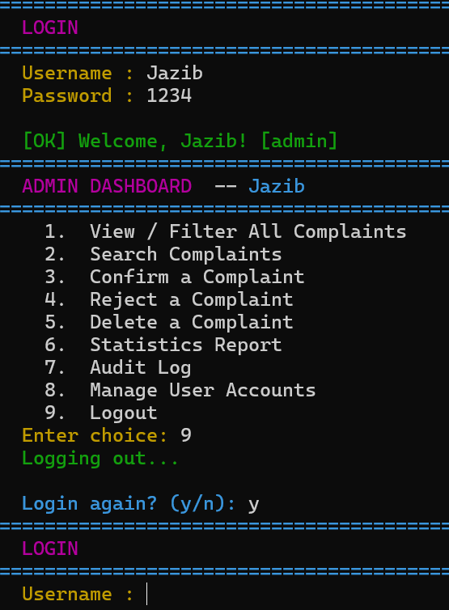
04 Admin Features
📋 View & Filter Complaints
✅ Confirm Complaint
Admins can filter complaints by status and priority.
Approve complaints and attach admin notes.
❌ Reject Complaint
📊 Statistics Report
Reject complaints with proper reason and feedback.
Generate complaint statistics using ASCII charts.
🧾 Audit Logs
👥 Manage Users
Track all important system activities with timestamps.
Add, delete, and manage user accounts securely.

Slide 8
05 Data Storage & Persistence
users.txt
complaints.txt
audit.txt
Stores:
Stores:
Stores:
username
complaint details
timestamps
timestamps
password
status
actors
role
priority
actions
Admin notes
Key Points:
Key Points:
Key Points:
Role-based access
Persistent complaint records
Activity tracking
Loaded at startup
Loaded into STL vectors
Append-only logging
Saved after changes
Auto-save after updates
Security accountability
Dashboard
File Handling
Users.txt/ complaint.txt/ audit.txt

Slide 9
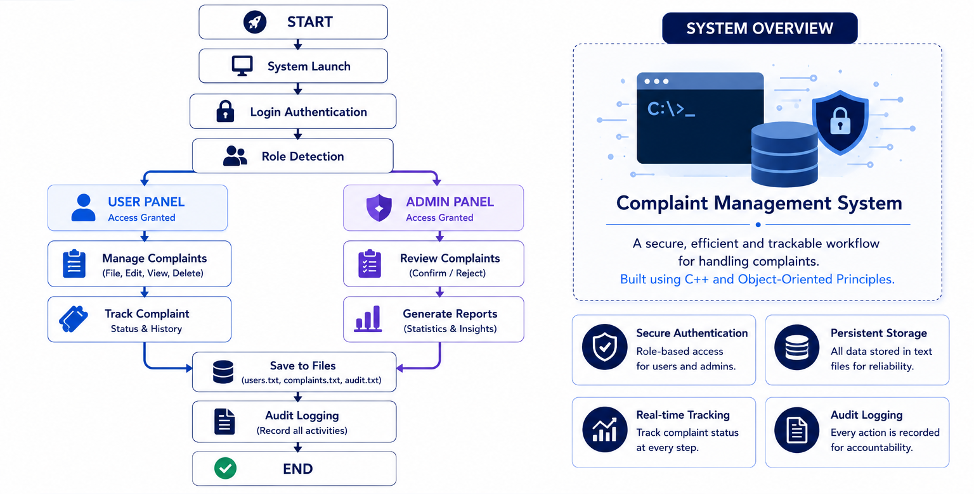
06 System Flow
START
→
→
→
→
END
System Launch
Login (3 attempts)
User Files Complaint
Admin Reviews
User Tracks Status
Logout / Re-login
First run: create admin & user accounts
Subsequent: load from users.txt
Enter username & password
Role detected → route to correct dashboard
Pick category, priority
Enter description → CMS-XXXX issued
Confirm or Reject with note
Action logged to audit.txt
Enter tracking number
See updated status + admin note
Session ends cleanly
All data persisted to files
Every action that modifies data triggers a saveComplaints() / saveUsers() call and a log() entry — ensuring zero data loss between sessions.

Slide 10
Complaint Management System
A fully functional, OOP-designed C++ application demonstrating real-world software concepts including role-based authentication, persistent storage, audit trails, and a clean console UI.
Thank You
Role-Based Login
Complaint Lifecycle
File Persistence
Audit Logging
Priority & Category
Admin Management
Please no Questions?

